Slide 1




NASA EXPLORER

Slide 2
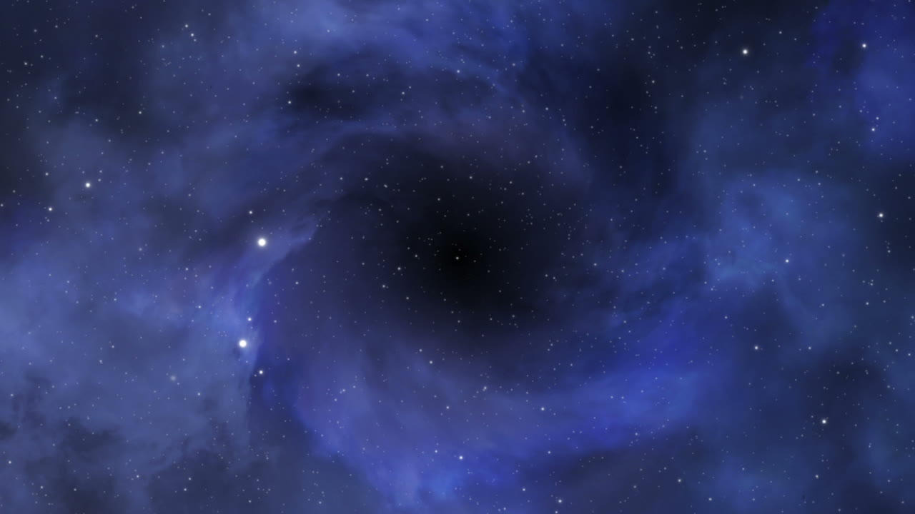
NASA EXPLORER

Slide 3

Introduction
In the pursuit of continuous exploration and innovation, the NASA Explorer project emerges as a pioneering platform that integrates modern technology with astronomical sciences. This project aims to provide a unique user experience by exploring new worlds and discovering the secrets of space. By combining advanced technologies such as 3D graphics and cinematic animations, the NASA Explorer project represents a significant step towards a more exciting future in web development and its applications.

Slide 4
Overview of the NASA Explorer Project
The NASA Explorer project is an advanced web application that aims to provide an immersive and integrated user experience. This project utilizes the latest technologies in web development, such as React, Vite, and Three.js, to present rich and interactive scientific content. The project allows users to explore new worlds and discover the secrets of space through an interactive and exciting experience.

Slide 5
key features
Intelligent Theming
Automatic theme switching based on user’s local time, with customizable day/night modes and a live timer & date widget.
Interactive Charts and Maps
Bilingual Support
Searchable/sortable tables, interactive charts with Chart.js, and a global map with React-Leaflet.
Full English/Arabic bilingual support with RTL handling, powered by i18next.
3D Graphics
Immersive 3D scenes with Three.js, featuring a rocket, orbiting planets, and a starfield canvas.

Slide 6
Goals and Features
The NASA Explorer project aims to provide a unique user experience by combining modern technologies with scientific content. Some of the key features of the project include:
1. Immersive User Experience: The project uses advanced technologies such as 3D graphics and cinematic animations to provide an immersive user experience.
2. Intelligent Design: The project allows users to customize their experience through an automatic day/night mode switch based on local time.
3. Bilingual Support: The project provides full support for both English and Arabic languages, with right-to-left handling for Arabic.
4. Interactive Charts and Maps: The project presents interactive charts and global maps to display scientific data.

Slide 7
Technologies Used
Technologies UsedThe NASA Explorer project utilizes a range of modern technologies in web development, including:
1. React and Vite: The project uses the latest versions of React and Vite to provide a fast and optimized development experience.
2. Three.js: The project uses Three.js to render immersive 3D graphics.
3. Tailwind CSS: The project uses Tailwind CSS to provide a consistent and easily customizable design.
4. i18next: The project uses i18next to provide bilingual support for English and Arabic languages.

Slide 8
Conclusion
The NASA Explorer project is a shining example of modern web applications that combine technology and astronomical sciences. By providing an immersive and integrated user experience, this project takes a significant step towards a more exciting future in web development.

Slide 9
Thank you

